Slide 1

Global Video Game Trends
By: Cameron Kilpatrick, Jacob Stegal, Yuli Likhonina, & Yash Patel
Notes:
*JACOB

Slide 2
Overview
Motivation:
We love video games!
Purpose:
Discover leading video game trends by country, publisher, console, and genre from 1980 to 2016
Overall Question:
What effects did the platform, year, genre, console, and publisher have on the overall sales of the regions?
Notes:
*JACOB

Slide 3
Data Set Exploration
What are the leading regions across global video game sales?
What are the drivers for the top video game release years?
What are the top video game publishers over the regions?
What are the top global video games and genres?
Notes:
*JACOB

Slide 4
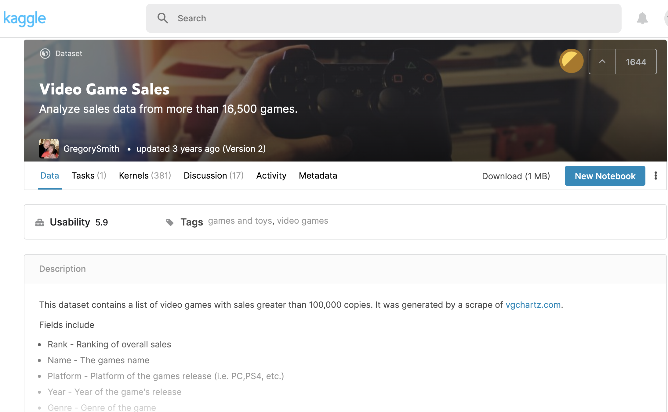
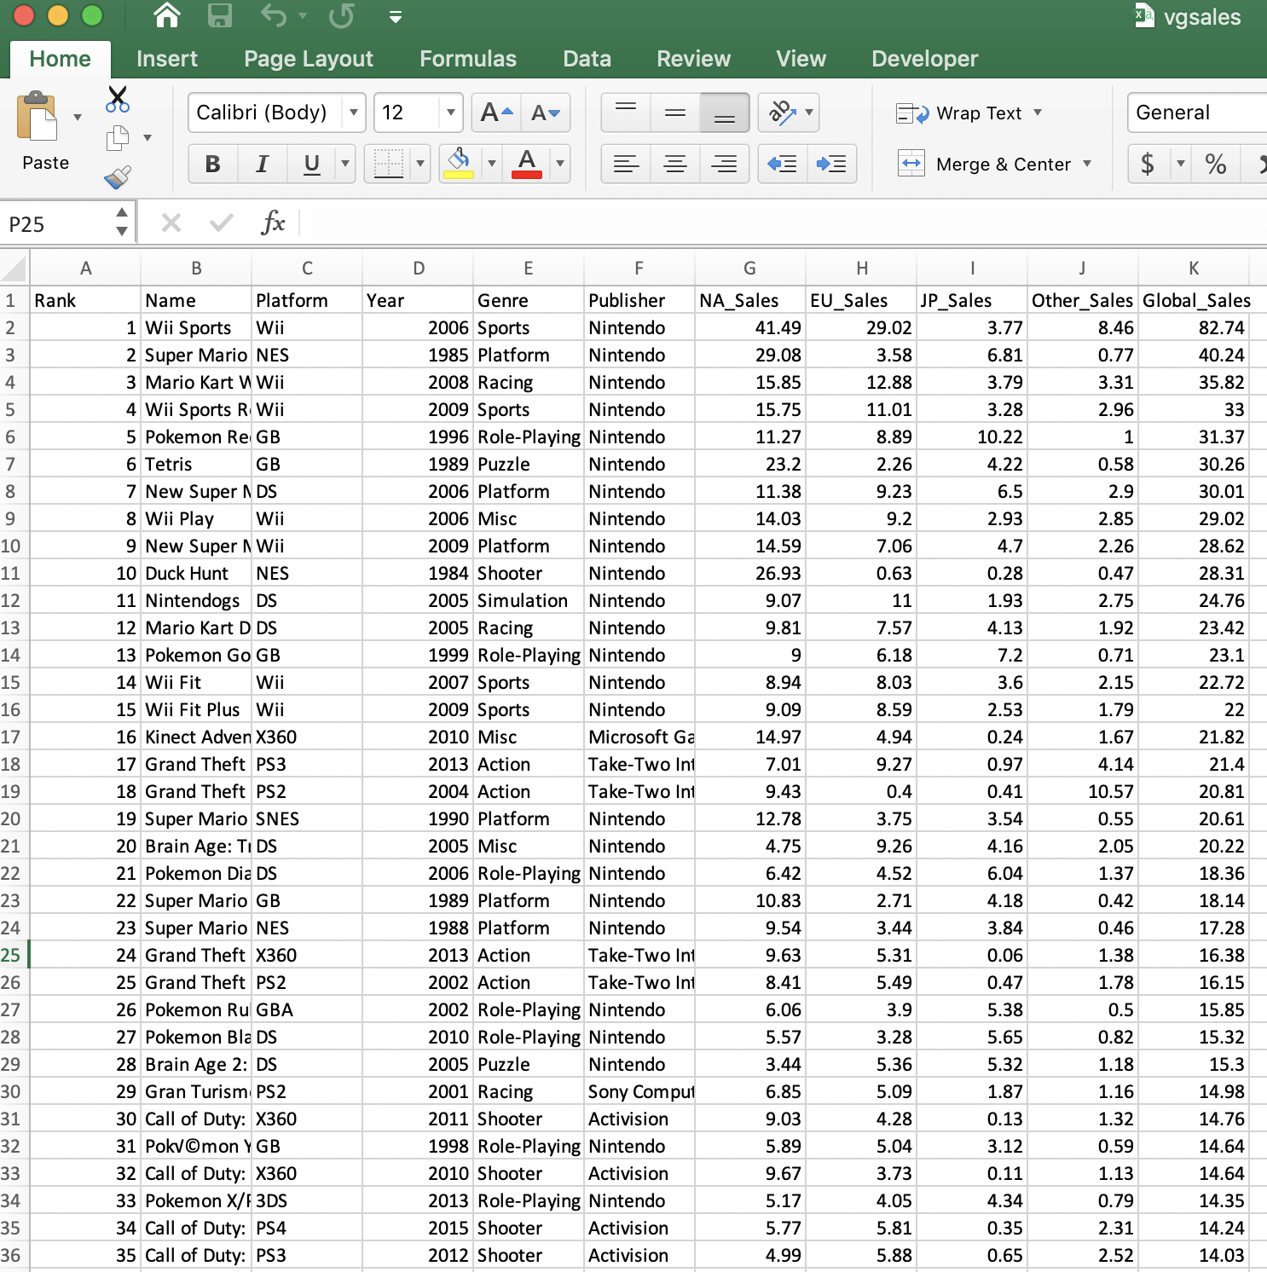
Global Video Game Data
Notes:
*JACOB

Slide 5
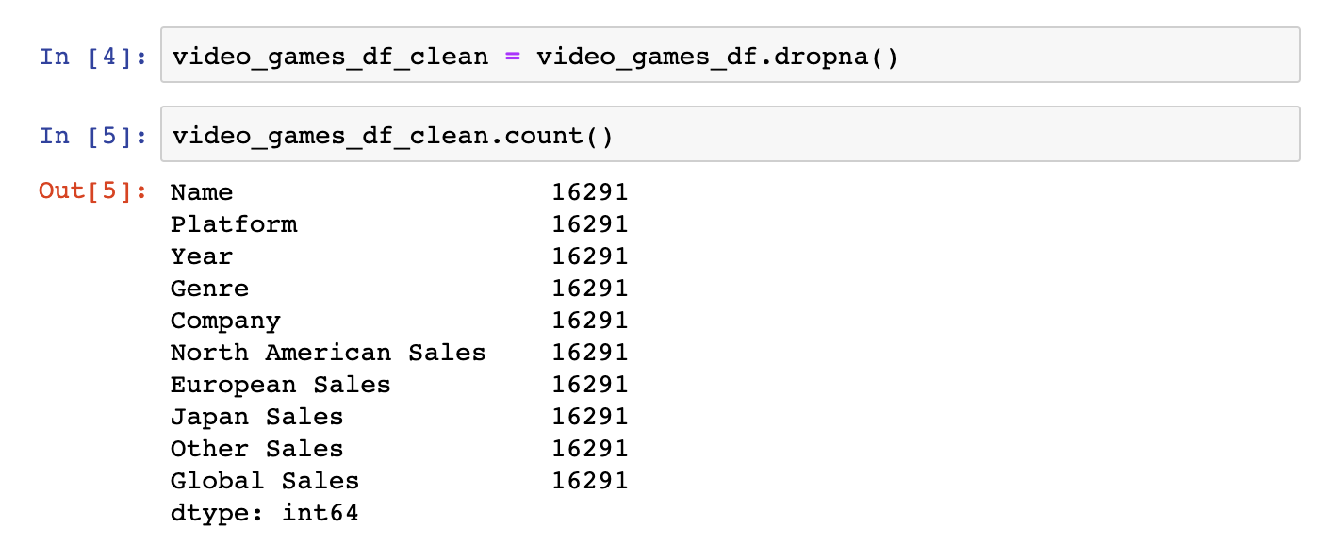
Data Set Clean Up
Notes:
*JACOB

Slide 6

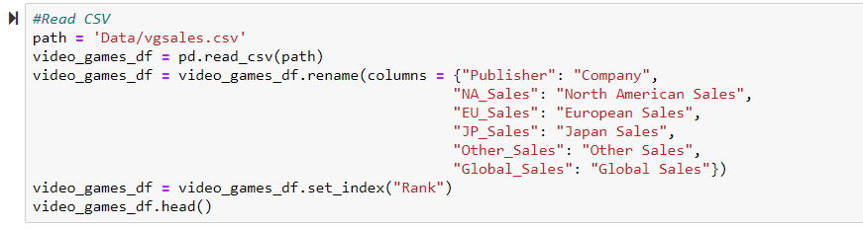
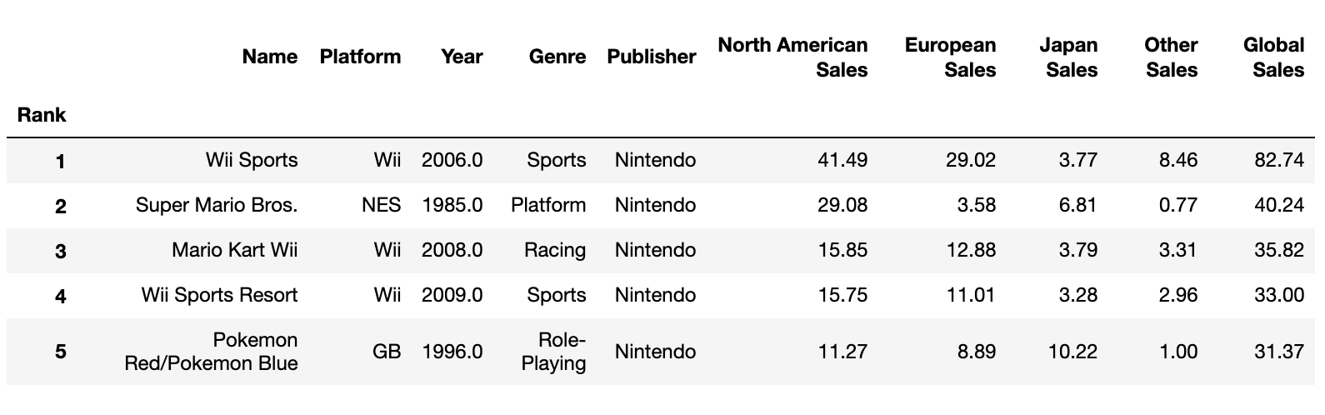
Developer Code
Notes:
*JACOB

Slide 7
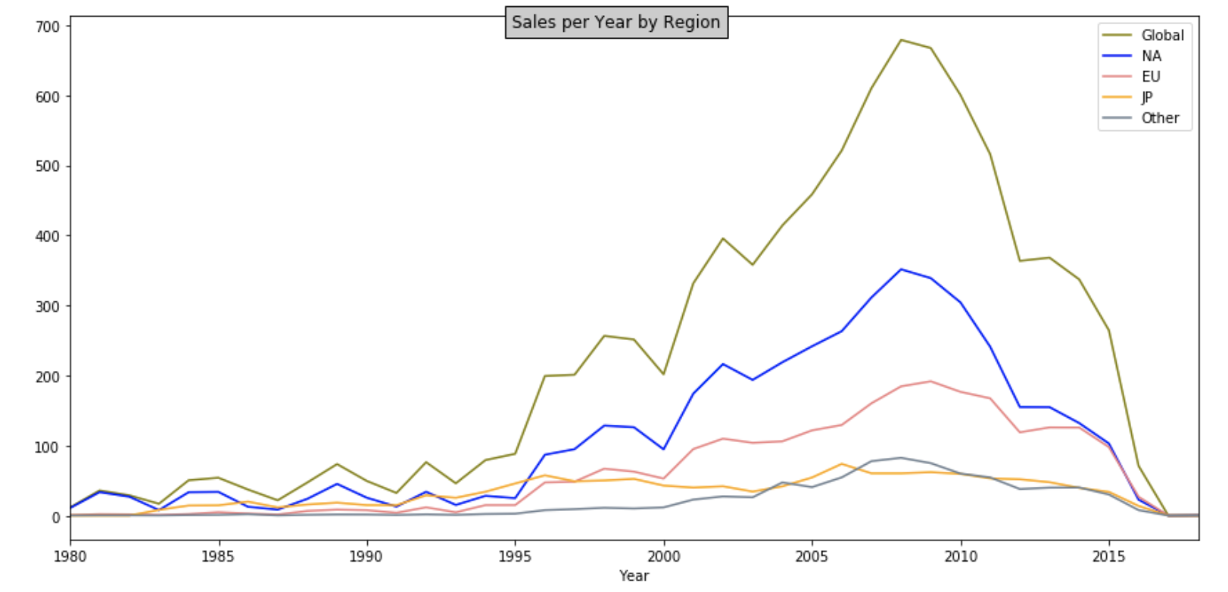
Regional Video Game Sales
Notes:
*YASH
North America leads in video game sales over the years globally followed by Europe, Japan, and Other Countries which include Africa, Asia (excluding Japan), Australia, and South America

Slide 8
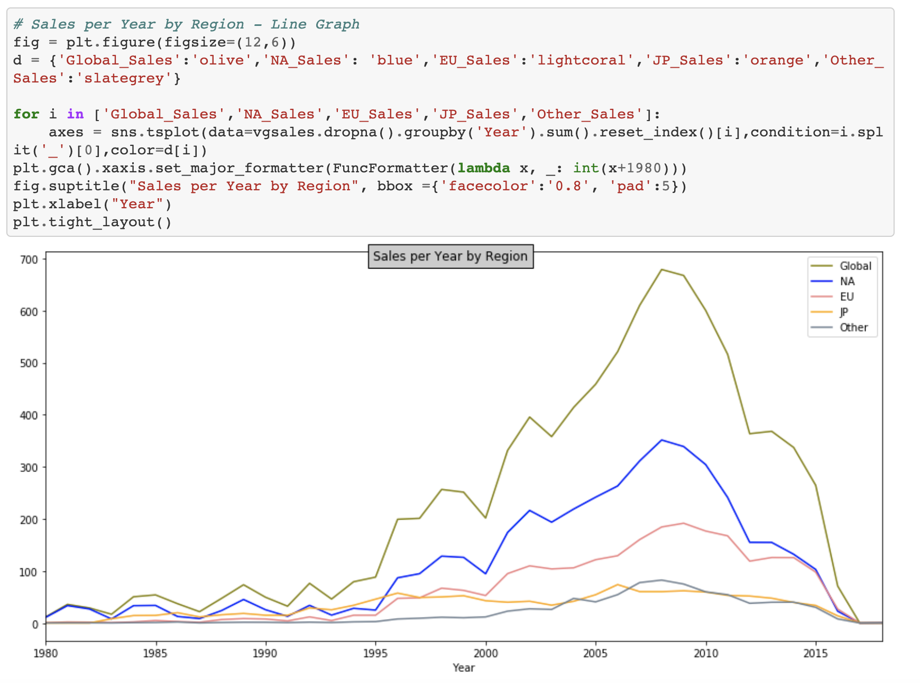
Developer Code
Notes:
*YASH

Slide 9
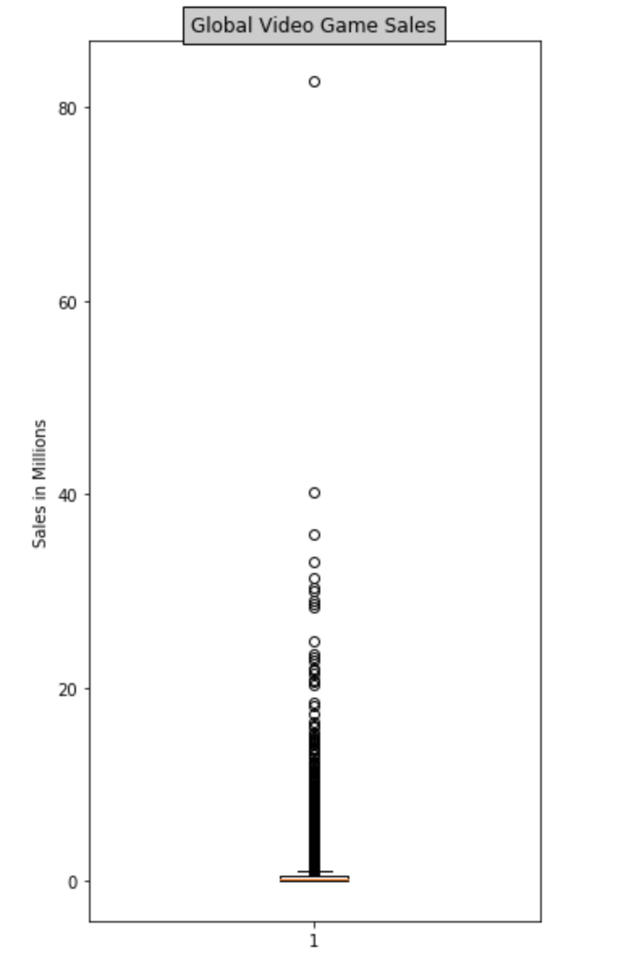
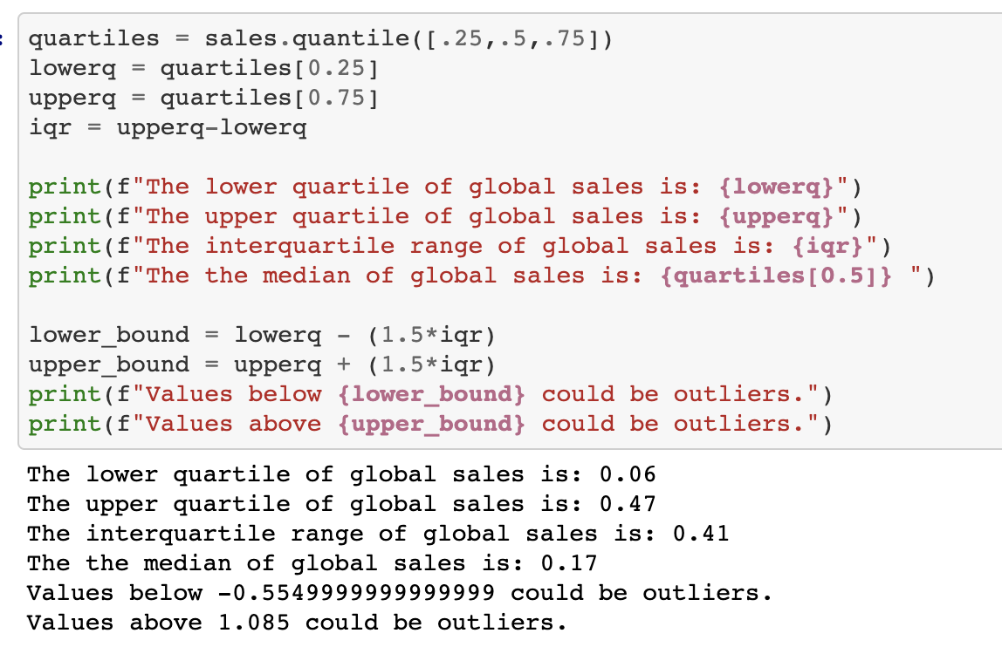
Global Video Game Sales Quartiles
Notes:
*YASH

Slide 10
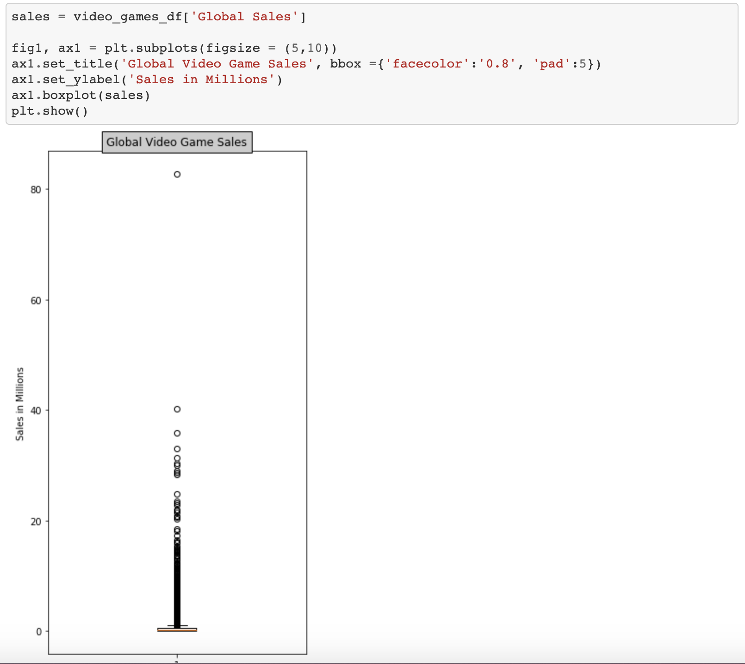
Developer Code
Notes:
*YASH

Slide 11
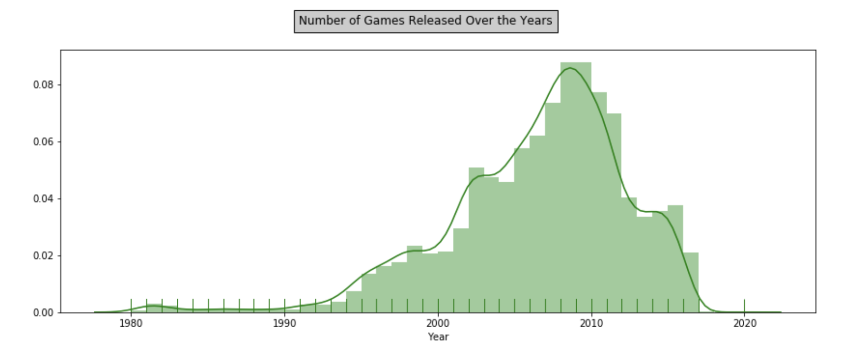
Top Global Video Game Release Years
Notes:
*YULI

Slide 12

Developer Code
Notes:
*YULI

Slide 13
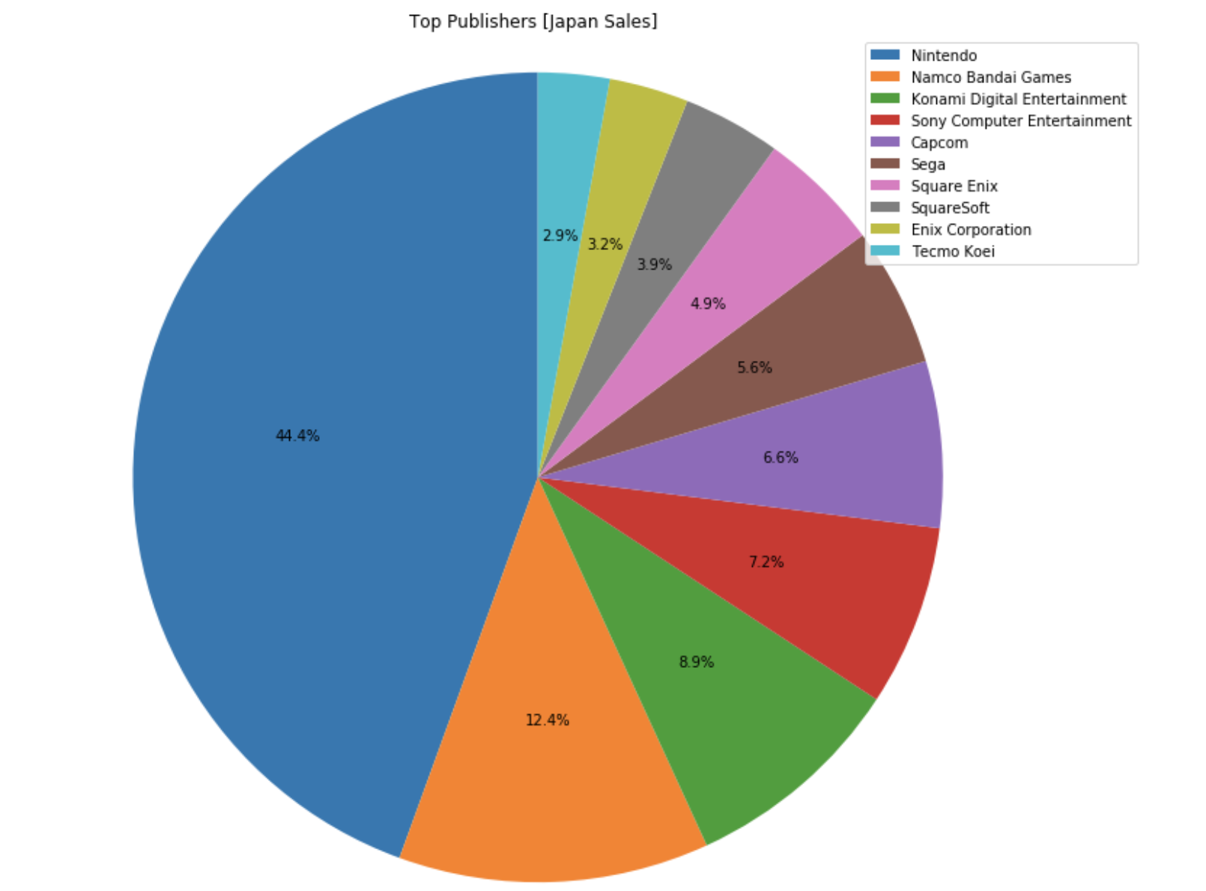
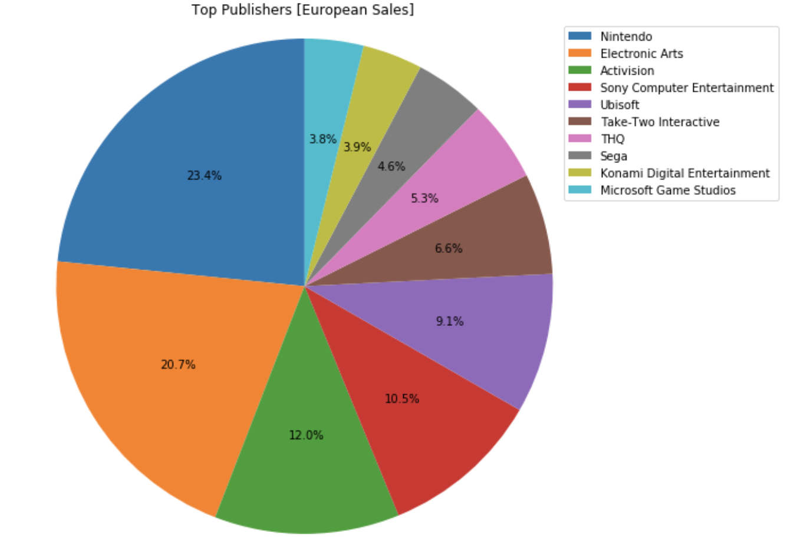
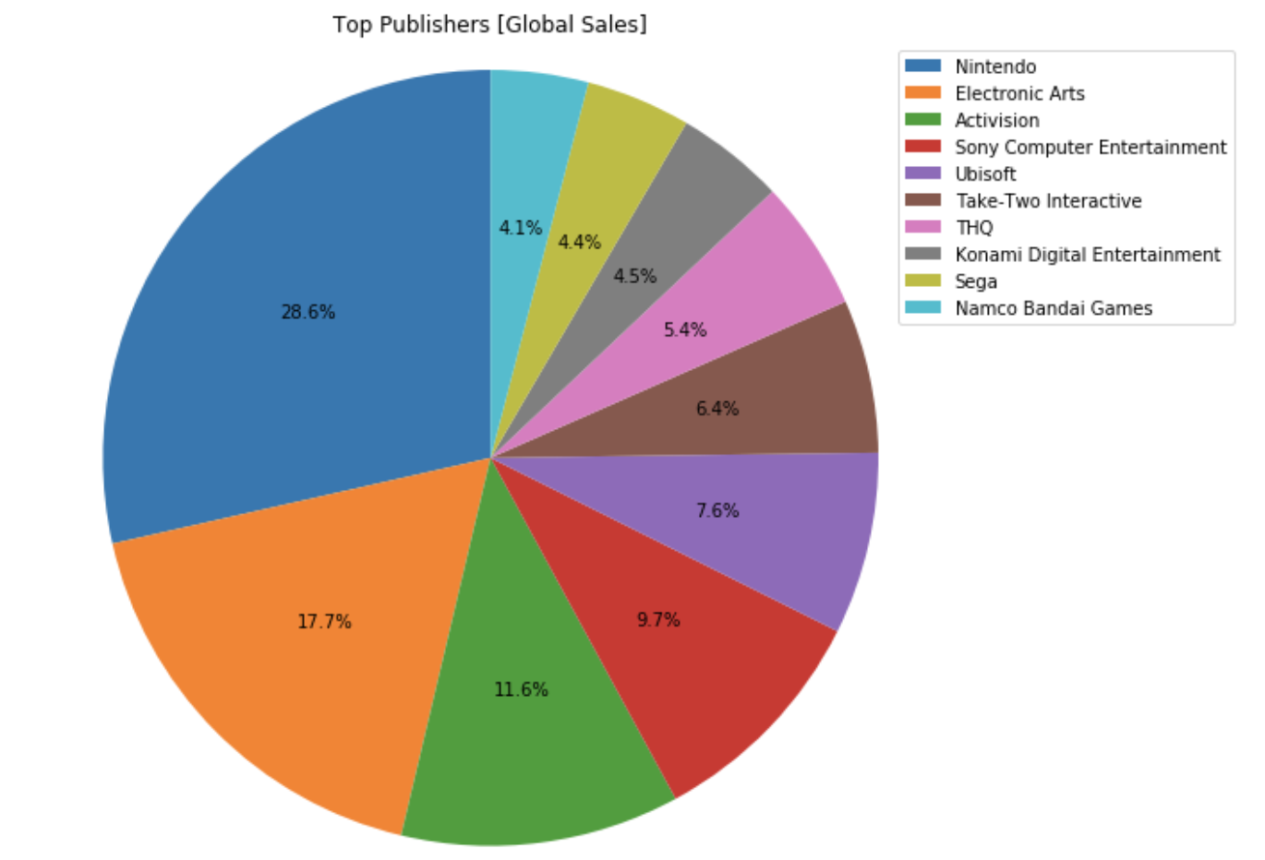
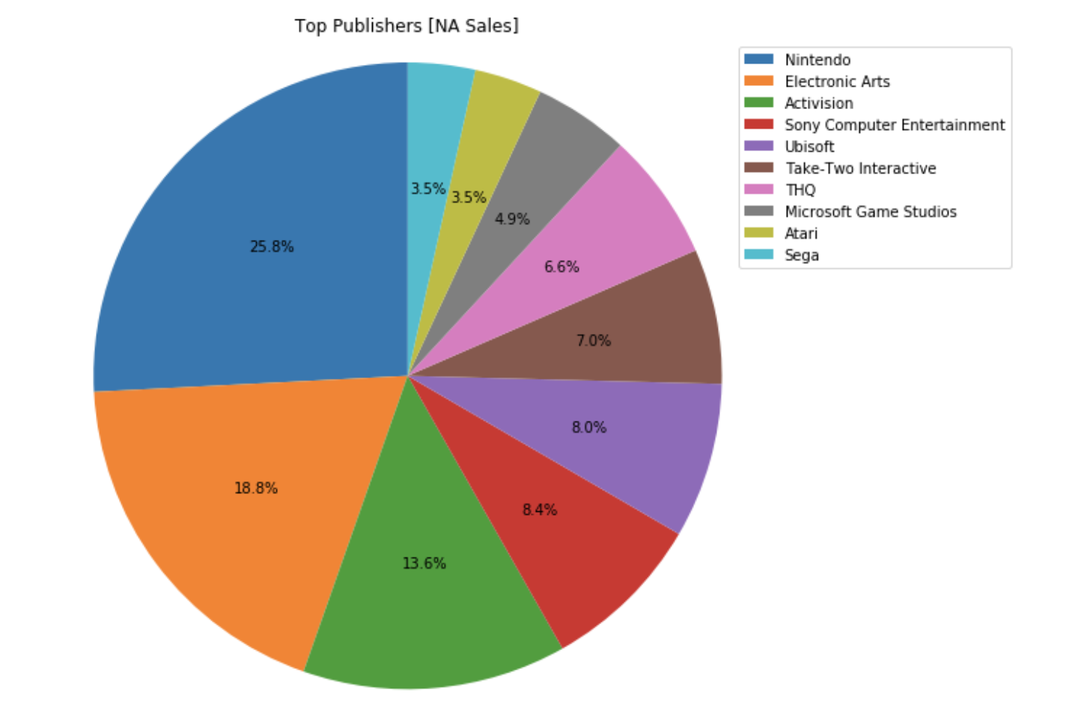
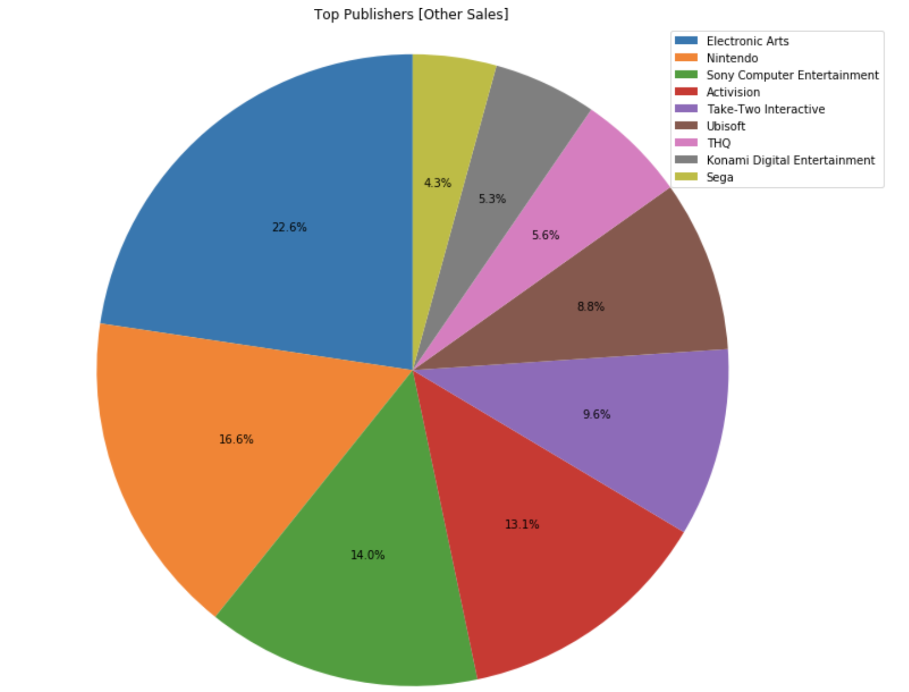
Top Video Game Publishers
Notes:
*JACOB
The leading video game publishers globally are Nintendo, Electronic Arts, Activision, and Sony
Global
Nintendo - 28.6%
Electronic Arts - 17.7%
Activision - 11.6%
Sony Computer Entertainment - 9.7%
Summary: from this data it can be concluded that Nintendo, Electronic Arts, and Activision are the top publishers globally and this is consistent when broken down by country/region.
The top video game publishers by region are as follows:
North America
Nintendo - 25.8%
Electronic Arts - 18.8%
Activision - 13.6%
Sony Computer Entertainment - 8.4%
European
Nintendo - 23.4%
Electronic Arts - 20.7%
Activision - 12%
Sony Computer Entertainment - 10.5%
Japan
Nintendo - 44.4%
Namco Bandai - 12.4%
Konami Digital - 8.9%
Sony Computer Entertainment- 7.2%
Other Countries
Electronic Arts - 22.6%
Nintendo - 16.6%
Sony Computer Entertainment - 14%
Activision - 13.1%

Slide 14
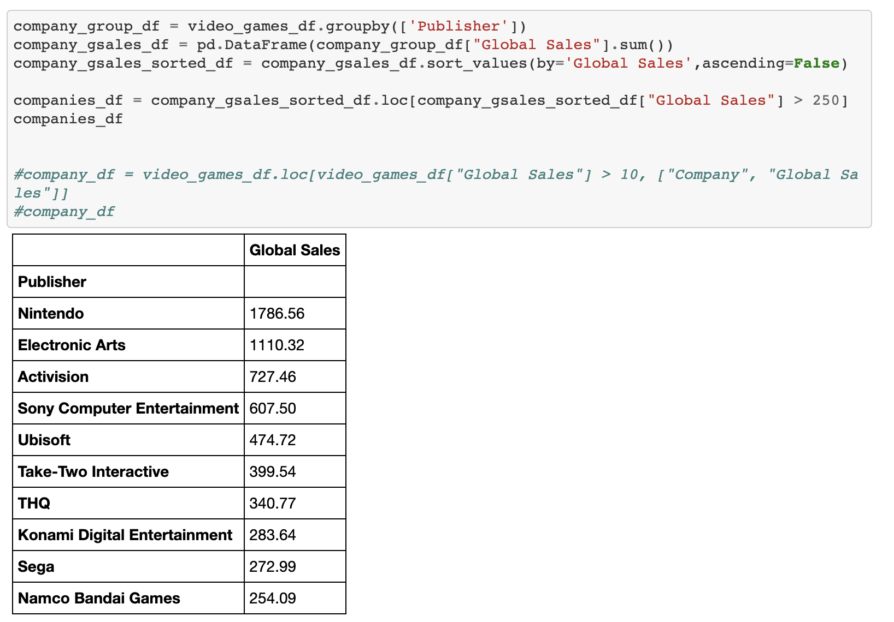
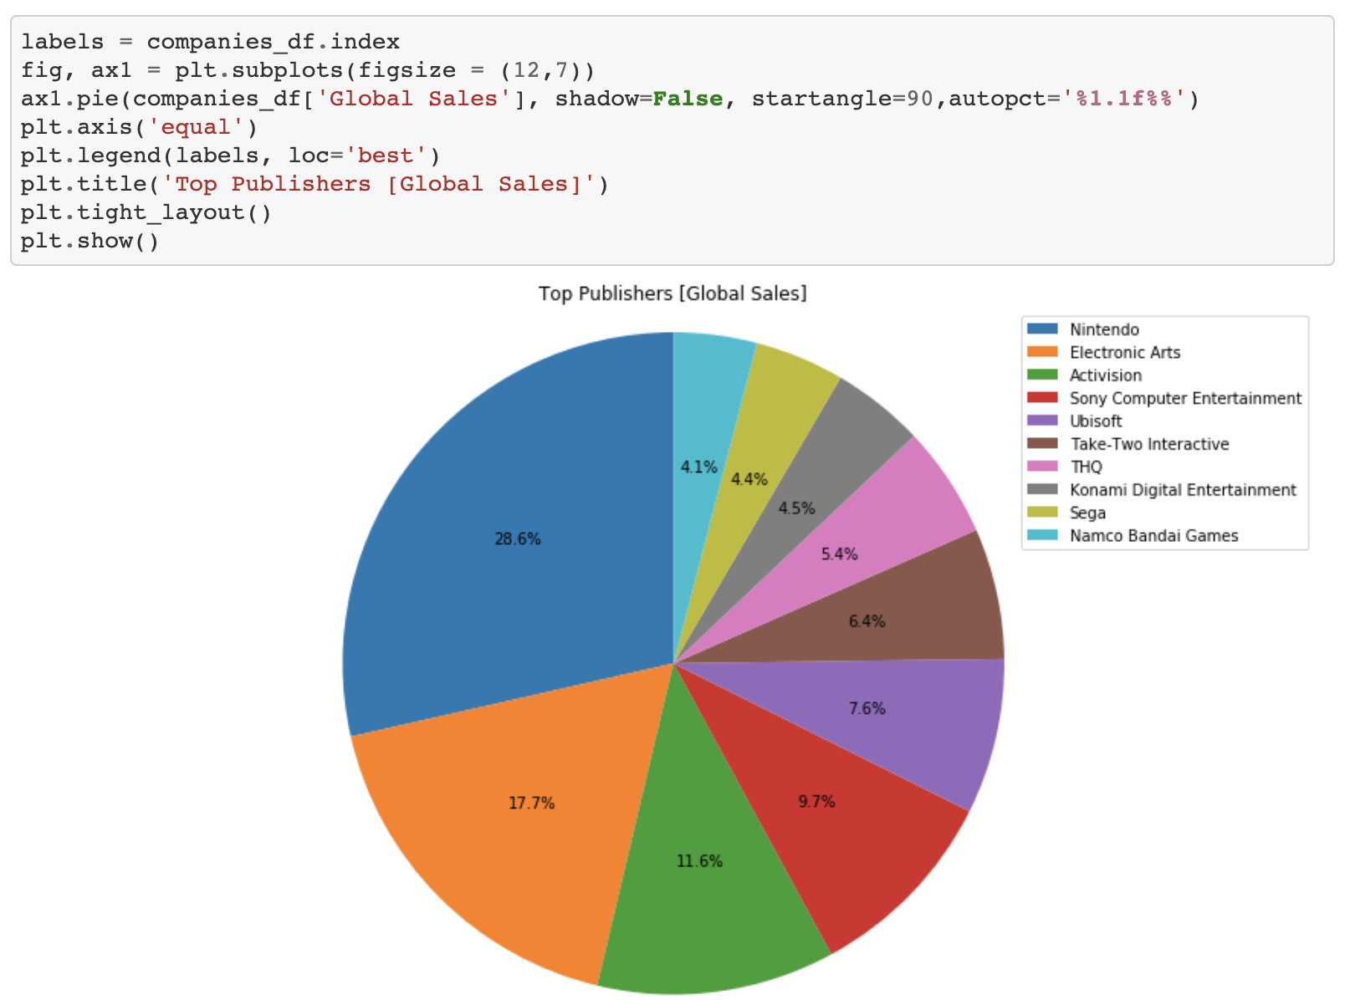
Developer Code
Notes:
*JACOB

Slide 15
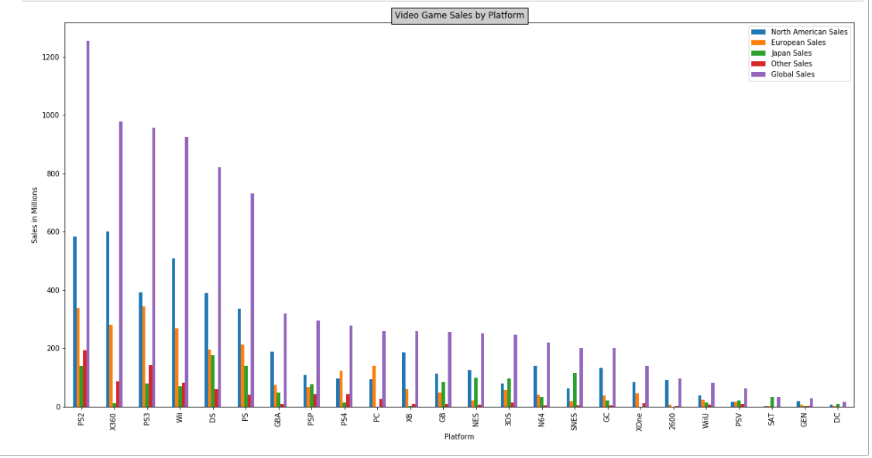
Top Video Game Consoles
Notes:
*CAM
The top leading video game consoles include the PS2, X 360, PS3, Wii, DS, and PS

Slide 16
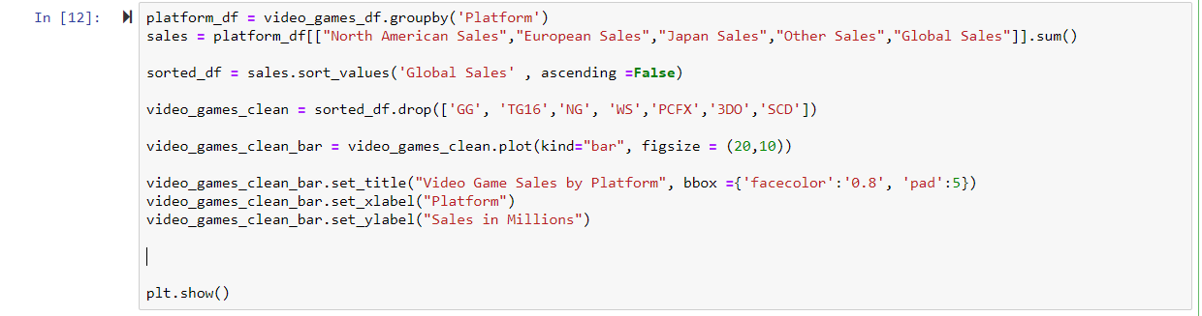
Developer Code
Notes:
*CAM

Slide 17
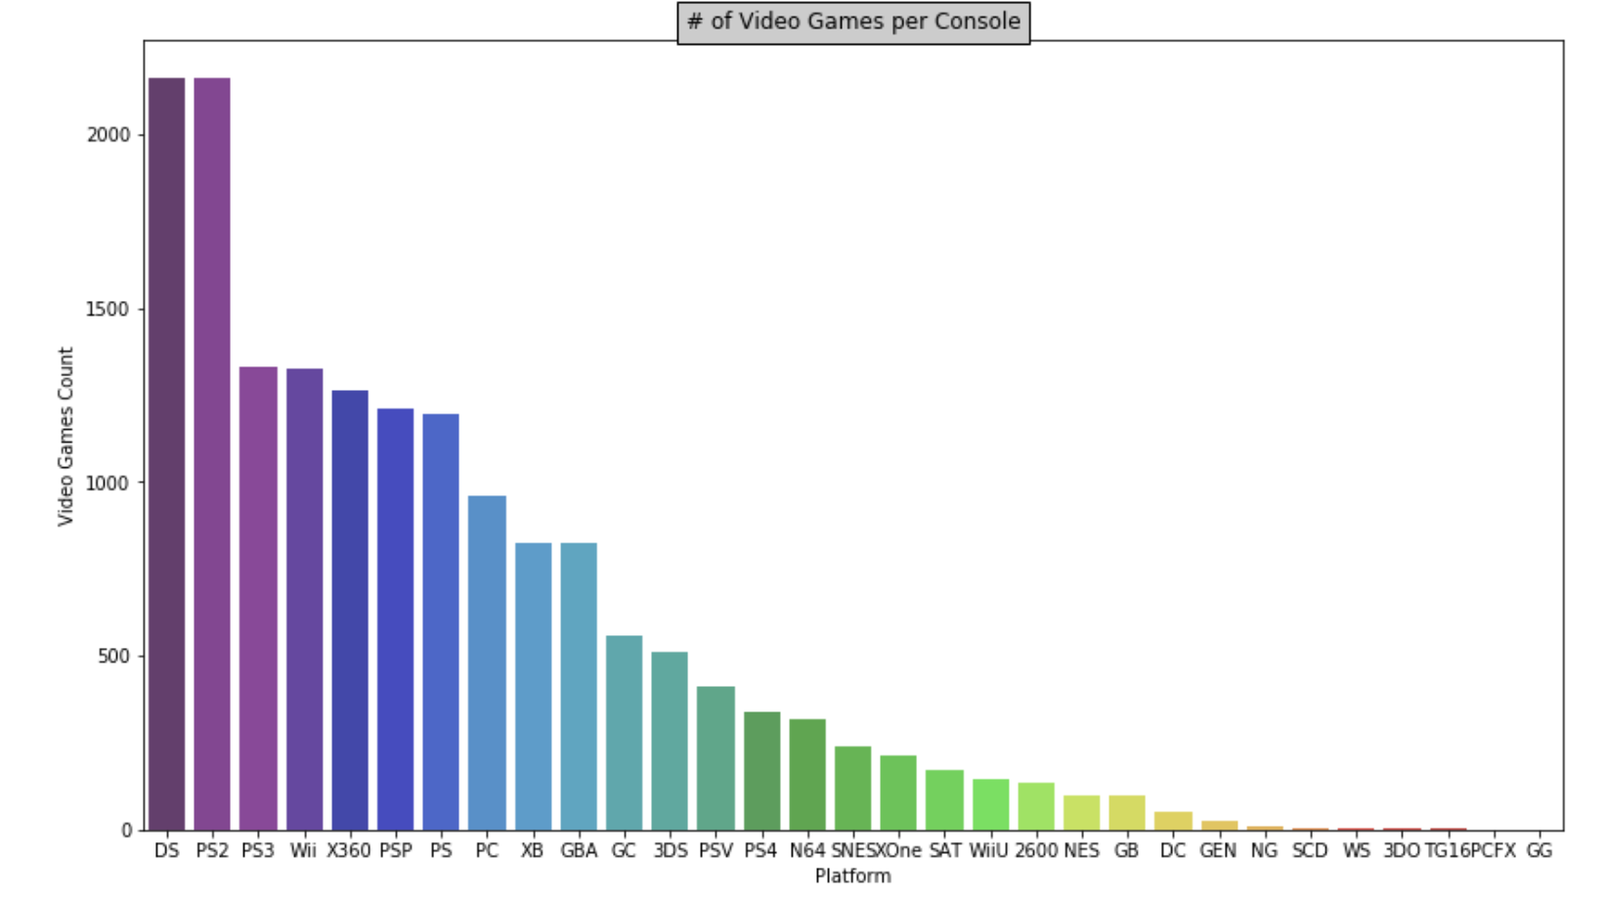
Leading Game Release Consoles
Notes:
*YULI
The leading consoles for the most number of games released include the DS, PS2, PS3, Wii, & X360

Slide 18
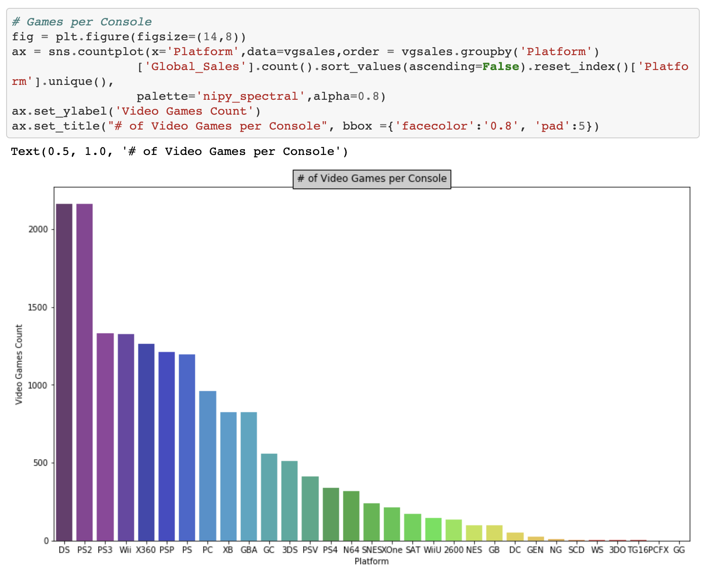
Developer Code
Notes:
*YULI

Slide 19
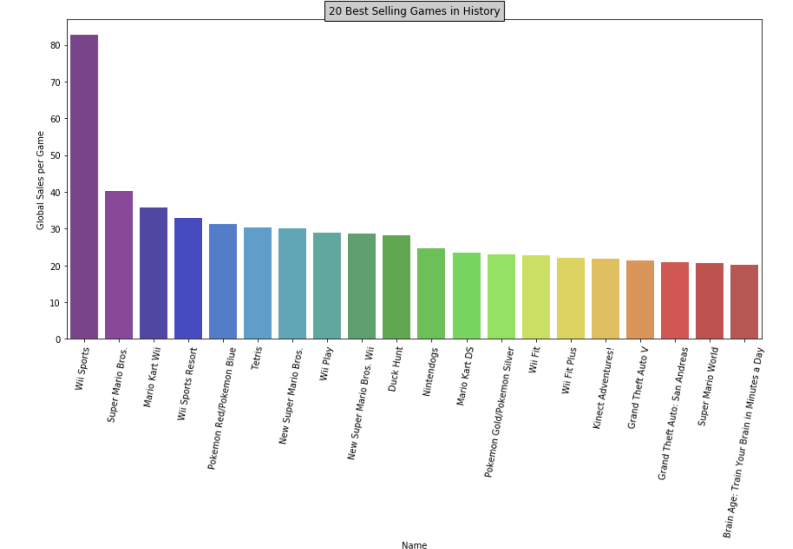
Top 20 Video Games
Notes:
*YULI
The top video games globally are Wii Sports, Super Mario Bros., Mario Kart Wii, Wii Sports Resort, and Pokemon

Slide 20
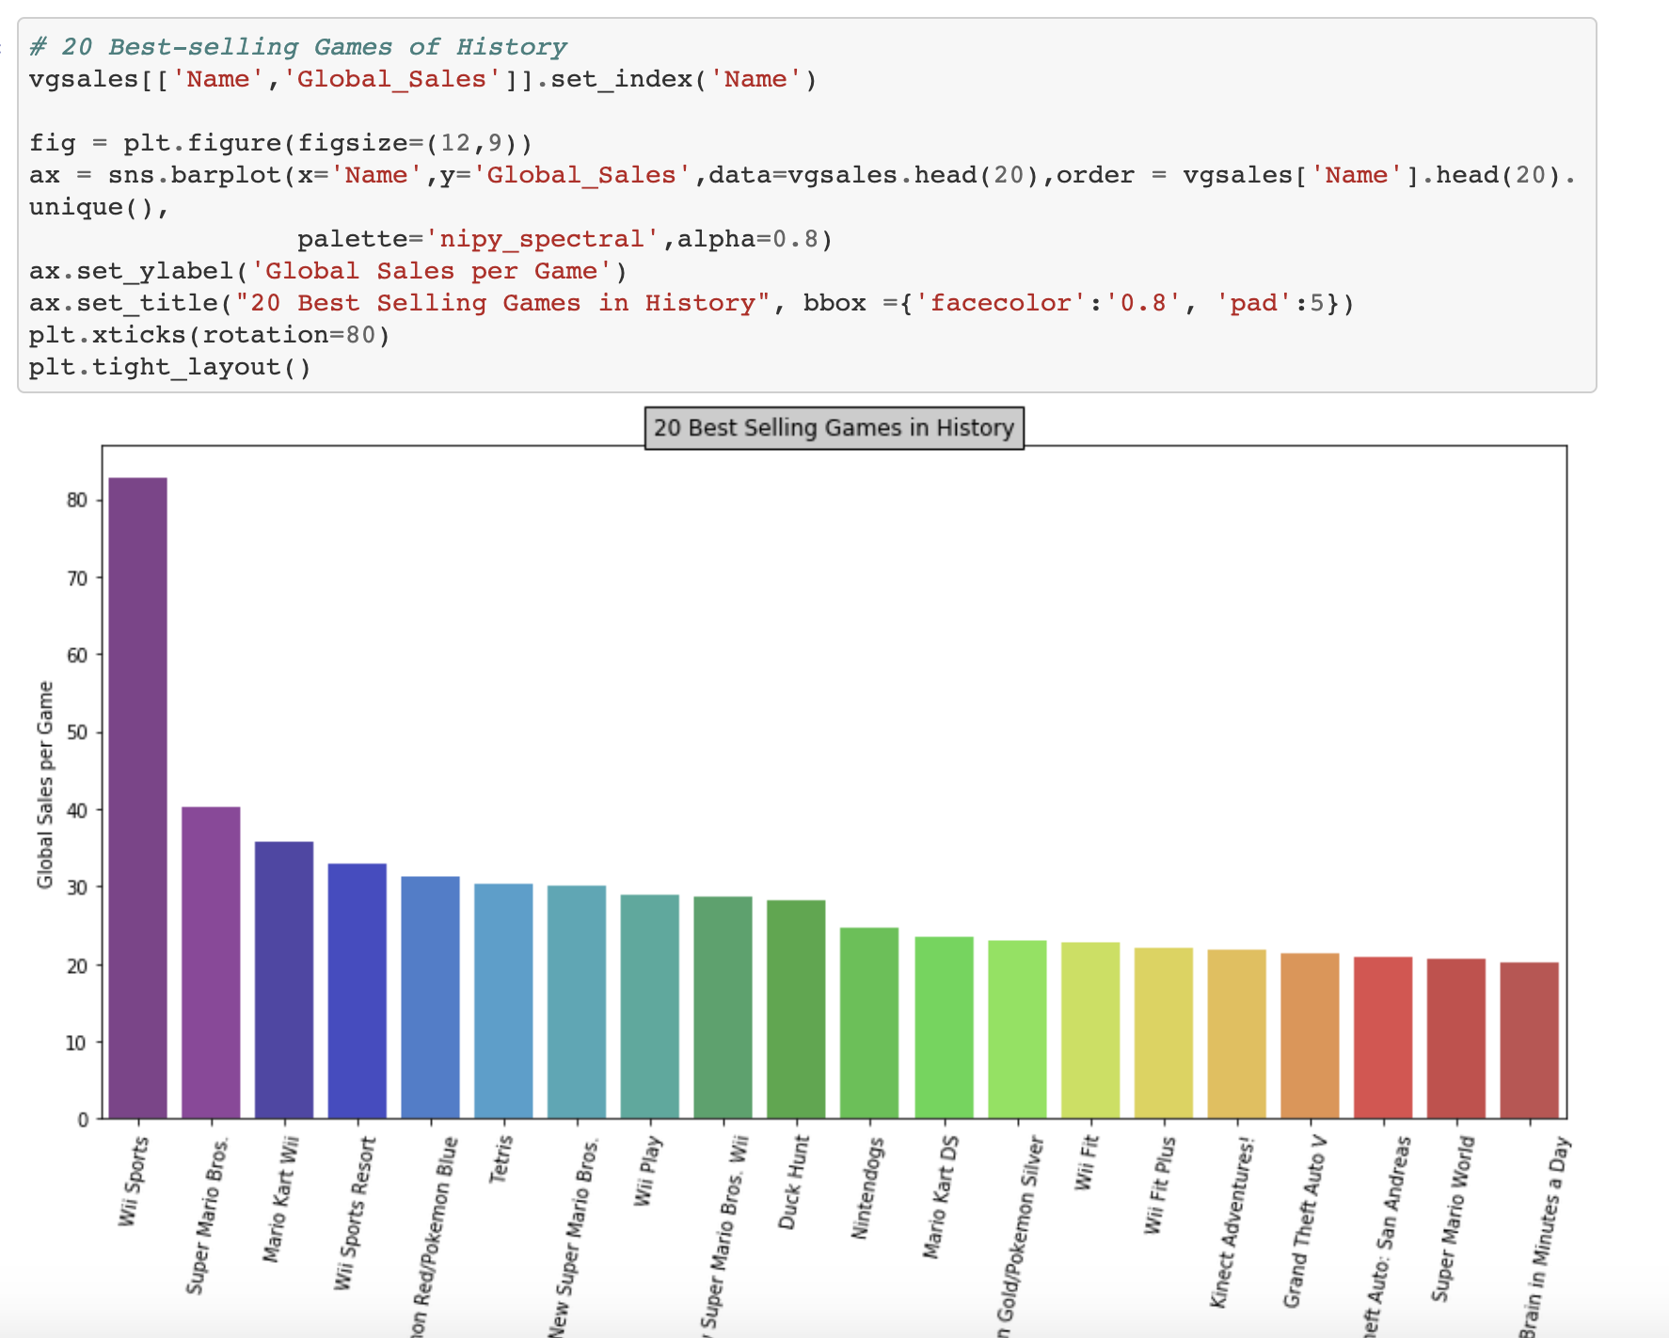
Developer Code
Notes:
*YULI

Slide 21
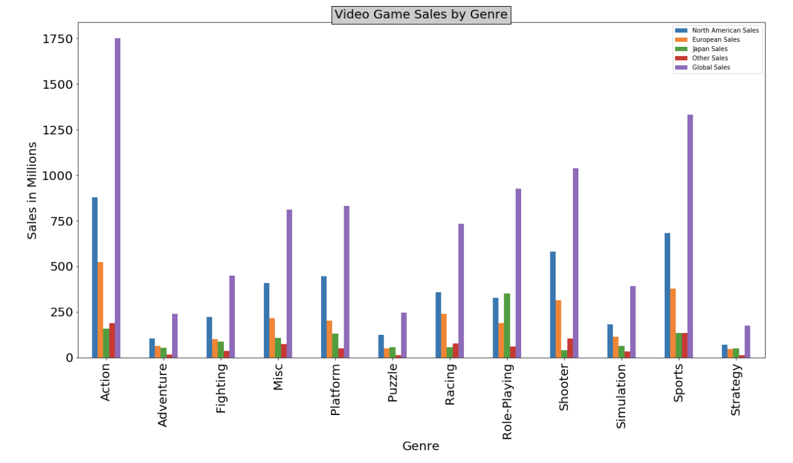
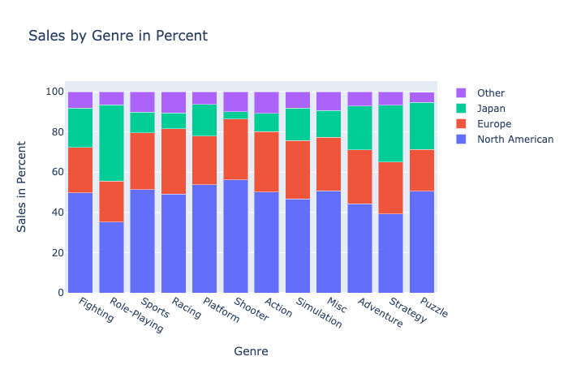
Top Video Game Genres
Notes:
*YASH
Action, Sports, Shooter, and Role Playing are the top leading global video game genres

Slide 22
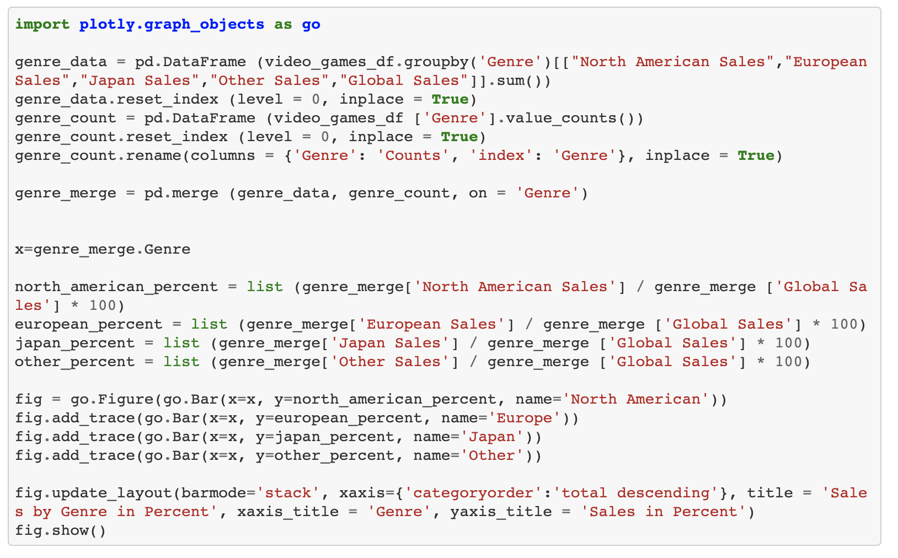
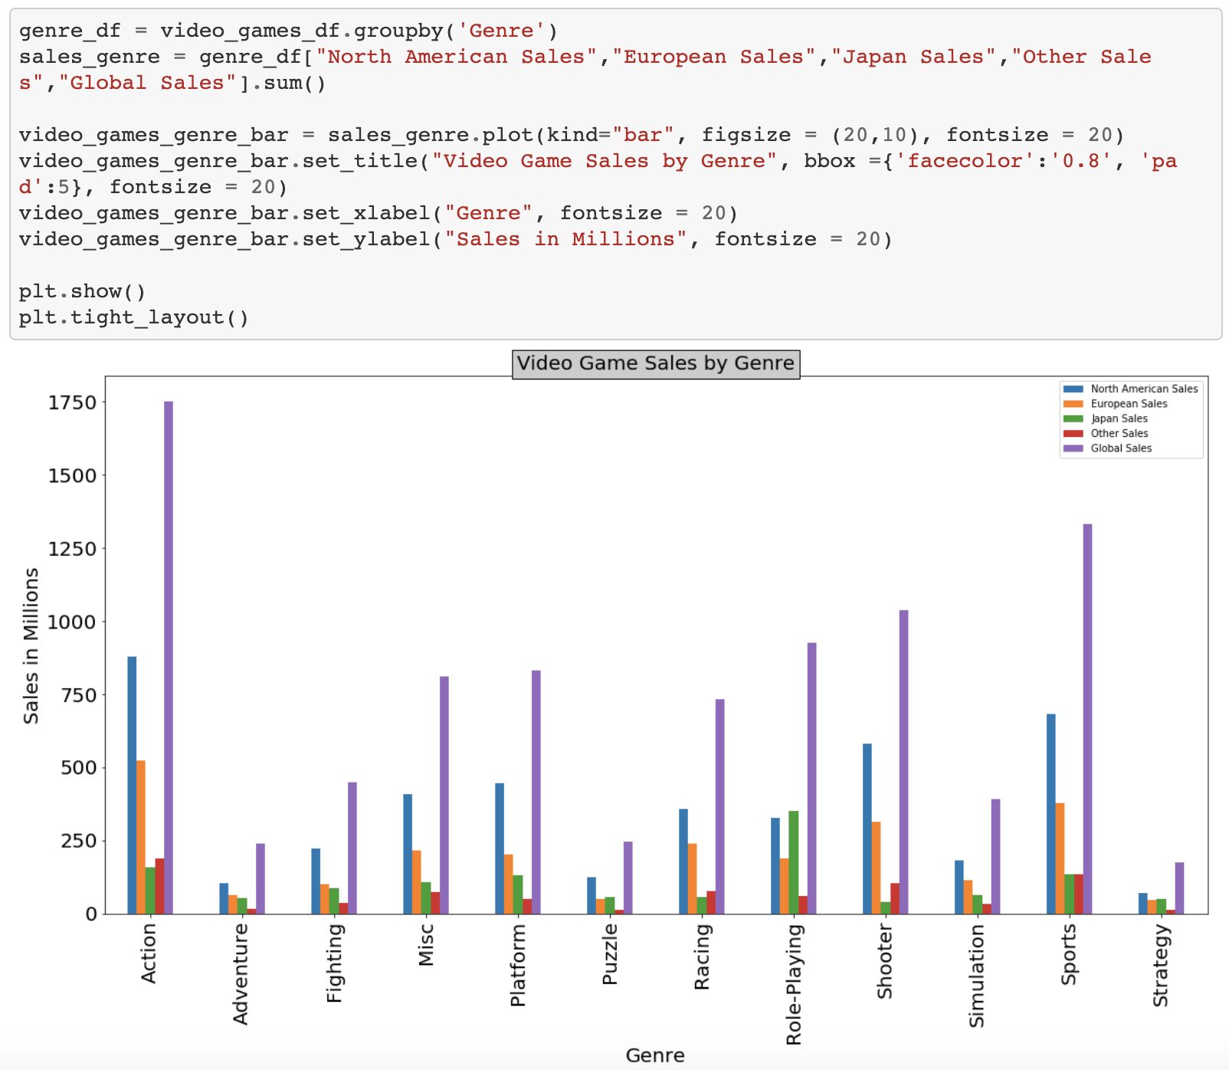
Developer Code
Notes:
*YASH

Slide 23
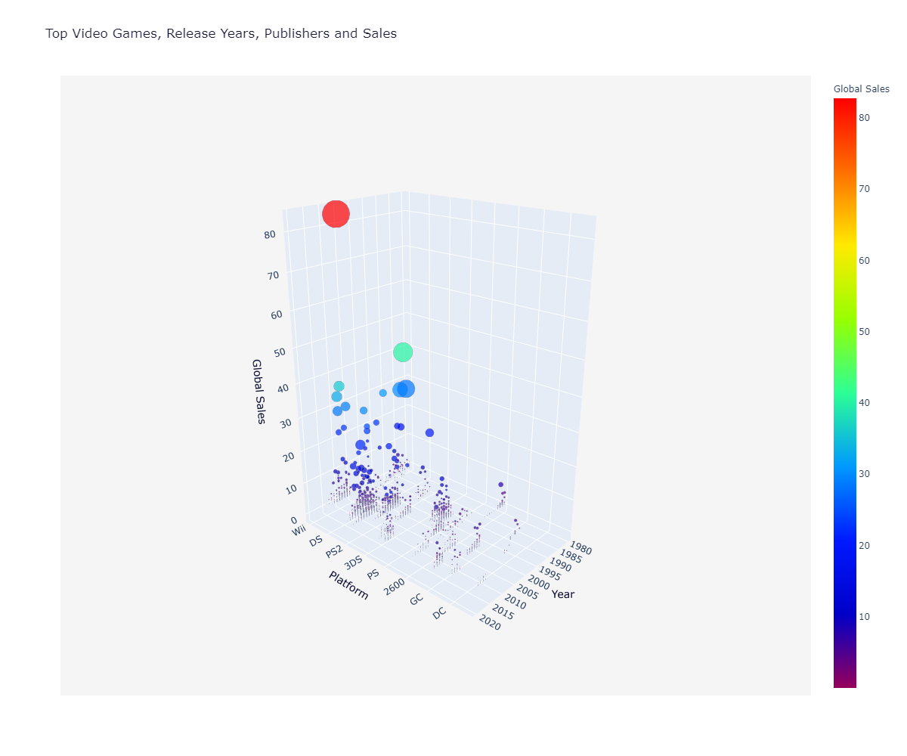
Top Video Games, Years, Publishers & Sales
Notes:
*CAM

Slide 24
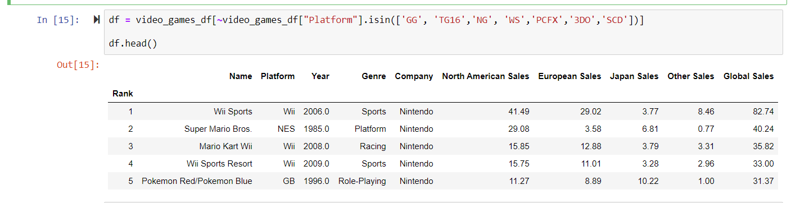
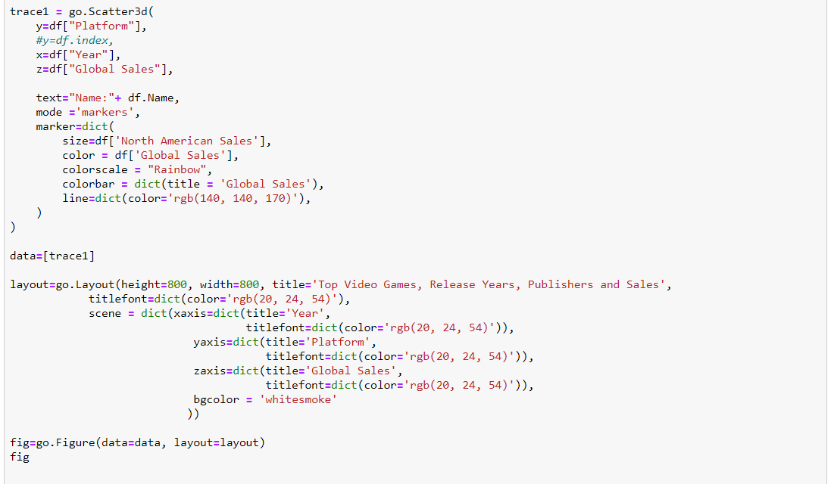
Developer Code
Notes:
*CAM

Slide 25
Global Video Game Conclusions
What are the leading regions across global video game sales?
Why does North America have the most sales in comparison to the rest of the world?
What are the drivers for the top video game release years?
Why did sales increase starting in the year 2000?
How have the leading publishers influenced sales throughout the years?
What are the top video game publishers over the regions?
Why does the Others region have the highest popularity in Electronic Arts while Nintendo leads globally?
What are the top global video games and genres?
Why does Japan have the lowest shooter game sales and highest role play video games in comparison to the rest of the world?
Notes:
Yuli
Cam
Jacob
Yash

Slide 26

Notes:
Q&A

